Slide 1
CSCI 599 : Content Detection and Analysis for Big Data
Mime-Types Around You
Aditya Sundaram
Rahul Radhakrishnan
Srinidhi Nandakumar

Slide 2
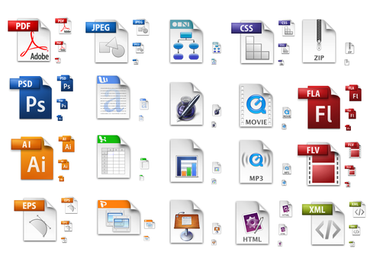
Quick RECAP...
Need for knowing MIME Types: We are learning Content detection, Without knowing MIME types, we cannot extract meaningful information.
Quick Fact: Over 1000+ registered MIME-types according to IANA.

Slide 3
DATASET 1
Uber/Lyft
Data stored in databases : MySQL
.FRM - Stores table definition
.MYD - Data file that stores the tuples in the table.
.MYI - Index files for the tables
.TMD - intermediate data file format before it recreates data file with full data.
.TRG, .TRN - Trigger definition files
They are classified under the major category of Application under the prominent top-level categories.
Apps that can read/write - MYSQL Server or Visual Basic
.MYI
MYsql Index
.TMD
.TRG .TRN
.MYD
MYsql Database
.FRM
FoRMat
Notes:
http://whatis.techtarget.com/fileformat/FRM-MySQL-table-formatting-file
https://www.reviversoft.com/file-extensions/frm
http://www.file-extension.com/files/FRM/

Slide 4

DATASET 1
Uber/Lyft
Beware! Same file extensions can be used by different applications to store data that mean different things.
Example : Oracle uses .FRM extension as executable!
That's why we use sophisticated methods such as Byte Frequency Analysis.
Some other MIME-Types associated with Uber/Lyft : text/plain, pdf (Bills)
Notes:
This is what makes the problem of building a generic content extraction tools more difficult.

Slide 5

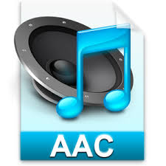

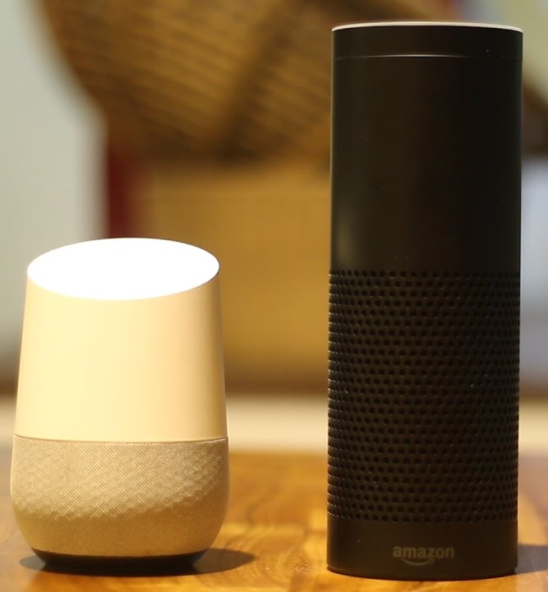


DATASET 2
Google MINI
( Smart ASsistanTS)
Audio formats : MPEG, AAC, WAV, AIFF, WMA
MP3 is a lossy compression format that loses some of the original audio in order to compress the file better.
Encoding - VBR, CBR. (128,192,256 kbps)
Top level type is Text and Audio.
Fun Fact : Browsers sniff on data sent across and determine MIME-types by going through content not extension.
`X-Content-Type-Options=nosniff` to prevent Chrome from doing mime detection
Notes:
https://www.makeuseof.com/tag/audio-file-format-right-needs/
https://www.lifewire.com/mp3-vs-aac-iphone-file-types-1999464
AIFF: Audio interchange file format
WMA: Windows media audio
MP3: Audio coding format for MPEG(Moving Pictures Expert Group)
AAC: Advanced audio coding
WAV: WAVE or Waveform audio file format
VBR: Variable bit rate
MPEG 1, layer 3 files (.mp3 files) are encoded with a specified bit rate, usually 128 kbps (thousand bits per second) or, sometimes 160 or 192 kbps. Better bit rates generally mean better sound quality and a closer representation of the original sound. VBR might not be compatible with old electronic devices
CBR: Constant bit rate
The advantage of using the CBR method is that audio data typically processes faster (compared to VBR). However, the files that are created aren't as well optimized for quality versus storage like is the case with VBR.

Slide 6
Let's discuss the 5v's and some related applications!
Text - High Volume, Variety, Velocity and value, High Veracity
Applications : sublime,wordpad, Notepad, vim...
image - High Volume, High Velocity, High Variety, Low Value , Low Veracity. Applications :Google photos, Adobe Ps6..
Audio - Medium Volume, Medium Velocity, Medium Variety , High Value, Medium Veracity
Applications : vlc,quicktime, iMovie, Windows movie maker...
Notes:
I am going to talk about some of the top level MIME types in our data sets and their influence on the 5Vs. First is, Text, it has high volume (bills, profile information, ride history), high variety (different regions, different languages), high velocity(way too many rides), high value(credit card details, location details)
high veracity( ride history- data needs to be )
Discuss Deepfakes images/video where someone used CNNs to modify videos, have very accurate replacement of faces -> veracity of images and videos => We won’t know what is really true and what data is fake
Image - it is for obvious reasons, low variety and low value
Audio - Medium volume, variety and velocity because number of people involved with personal assistant is less but can have (different voices, different languages), high value(personal information, day to day activities), medium veracity(reminders, alarms)

Slide 7
Let's discuss the 5 v's and some related applications!
Deepfakes https://github.com/DerWaldi/youtube-video-face-swap
Browser and Javascript
People had problems rendering js initially in browsers as they were treated as text/plain.
Introduced a new mime type called application/javascript

